Slide 1
DATA 301 Introduction to Data Analytics Statistics: R
Dr. Ramon Lawrence
University of British Columbia Okanagan
ramon.lawrence@ubc.ca

Slide 2
What is R?
R is a free and open source programming language for statistical computing and graphics.
One of the most widely used programming languages for statistical analysis.
Popular in academia and companies like Microsoft, Google, and Facebook.
There are currently over 8000 packages in R.
(https://cran.r-project.org/web/packages/available_packages_by_name.html)
R creates high quality graphs and visualizations.

Slide 3
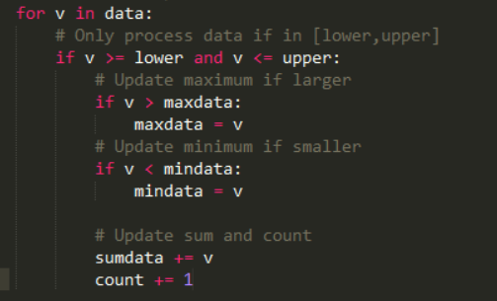
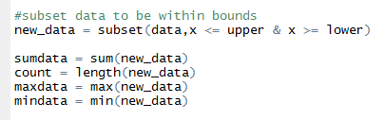
Why learn R?
R is built to handle and analyze data.
Example: Filtering a dataset to be within a lower and upper bound and then calculating summary statistics.
Python R

Slide 4
Statistics Review: Types of Data
There are two types of data:
Qualitative (Categorical)
Descriptions or groups
Can be characters or numbers
Observed and not measured
i.e. names, labels, categories, properties
Quantitative (Numeric)
Strictly numeric
Can be measured
i.e. height, weight, speed, counts, temperature, volume

Slide 5
Numerical Summaries
A numerical summary provides an overview of data to help understand it without examining all data values.
Use a measure of centre and a measure of spread to describe quantitative data.
Notes:
There are no numerical summaries for qualitative data, only graphical summaries.

Slide 6

Measures of Centre
Mean is the average of data values (sum of values divided by count).
$$\overline{y} = \frac{\sum_{i=1}^{n}{y_{i}}}{n}$$
Median is the value at which half of the data lies above that value and half lies below it.
Odd number of observations: $\tilde{y}$ is the kth value where $k=(n+1)/2$.
Even number of observations: $\tilde{y}$ is the mean of the kth and (k+1) terms, where $k=n/2$

Slide 7


Example Calculation for Mean and Median
Data:
$y= \left\{ 1, 3, 3, 7, 9 \right\}$
The mean and median are:
$\overline{y}= \frac{1+3+3+7+9}{5}$ = 4.6
$\tilde{y}=3$
In R, use the mean() and median() functions:

Slide 8

Measures of Spread
A measure of spread indicates how far apart the values are.
Variance - is the sum of the squares of each data point's distance from the mean.
$s^{2}= \frac{\sum_{i=1}^{n}{{(y_{i}−\overline{y})}^{2}}}{n−1}= \frac{\left(\sum_{i=1}^{n}{y_{i}^{2}}\right) −n{\overline{y}}^{2}}{n−1}$
Standard Deviation - is the square root of the variance.
$s= \sqrt{s^{2}}$
Range - is the maximum value minus the minimum value.
$\max{− min}$
Notes:
Note that some people may have been taught different definitions of range in other statistics courses.

Slide 9


Example Calculation for Variance/Standard Deviation
Data:
$y= \left\{ 1, 3, 3, 7, 9 \right\}$
The variance and standard deviation are:
$s^{2}=\frac{\left(1+9+9+49+81\right) −5∙{4.6}^{2}}{5−1}=10.8$
$s=3.286$
In R, use the var() and sd() functions:

Slide 10

Data Measures Question
Question: Using the data y, how many of the following are TRUE?
$$y= \left\{1,2,3,4,5,6\right\}$$
$\overline{y}= \tilde{y}$
$\overline{y}$ = 3
$s^{2}$ = 3.5
$range=6$
A) 0 B) 1 C) 2 D) 3 E) 4
Notes:
C - 2
True: #1, #3
Mean : 3.5
Median: 3.5
Variance: 3.5
Range: 5

Slide 11
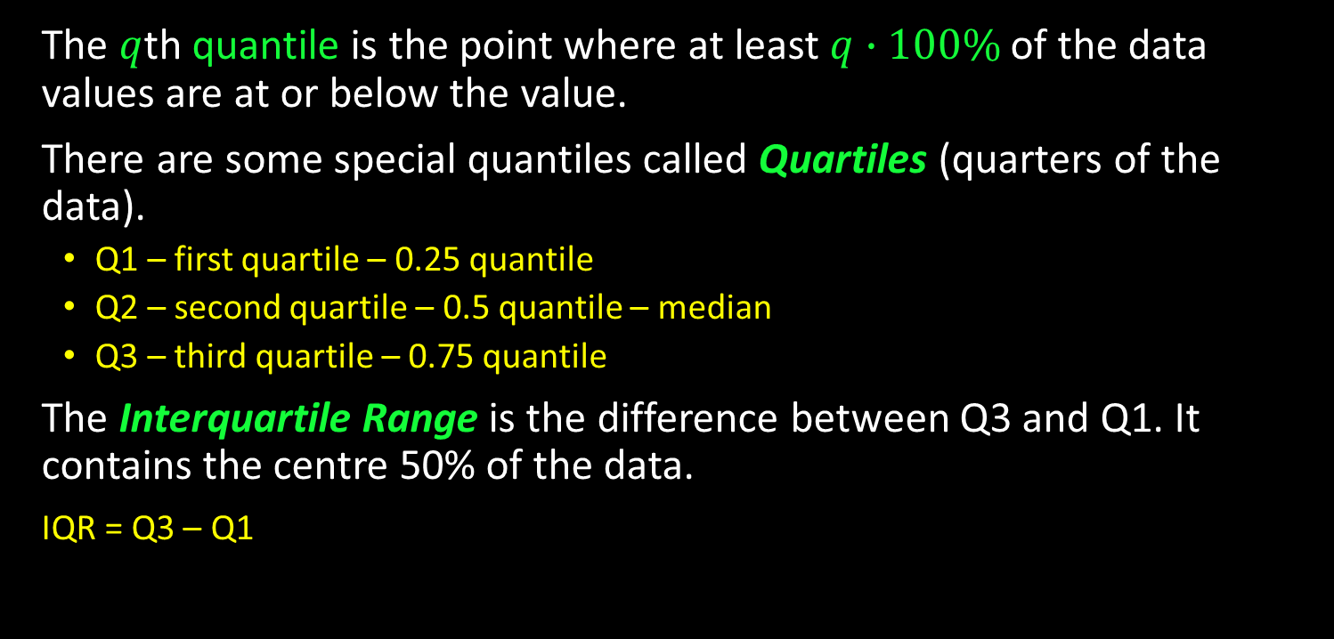
Quantiles and Quartiles
The $q$th quantile is the point where at least $q∙100\%$ of the data values are at or below the value.
There are some special quantiles called Quartiles (quarters of the data).
Q1 – first quartile – 0.25 quantile
Q2 – second quartile – 0.5 quantile – median
Q3 – third quartile – 0.75 quantile
The Interquartile Range is the difference between Q3 and Q1. It contains the centre 50% of the data.
IQR = Q3 – Q1

Slide 12

Example Quartiles
Data: $y= \left\{1,2,3,4,5,6\right\}$ Median: $\tilde{y}=\frac{3+4}{2}=3.5$
Q1 and Q3 are then the ‘medians’ of the two subsets of data when divided at the median
$y_{1}= \left\{1,2,3\right\}$ and $y_{2}= \left\{4,5,6\right\}$
$Q1=2, Q3=5$
The function is quantile() in R.
Notes:
Note: R uses a more sophisticated way to calculate quantiles.
Basic version does not return the same as calculated here. Use: quantile(data,type=1)

Slide 13

Quantiles Question
Question: Given $y=$integers from 0:100, how many of the following are TRUE?
The median and Q3 are 50 and 75 respectively.
Each integer y_{i} is the y_{i} /100th quantile. i.e. 5 is the 0.05th quantile.
For every data set, Q2 is strictly less than Q3.
If the data is reversed the quantile values remain unchanged.
A) 0 B) 1 C) 2 D) 3 E) 4
Notes:
D
#1, #2, #4
If data is uniform with all the same values, Q2 and Q3 would be the same.

Slide 14

Five Number Summary
A five number summary consists of the following:
minimum
Q1
median
Q3
maximum
Using $y= \left\{1,2,3,4,5,6\right\}$ the 5 number summary would be:
Min Q1 Median Q3 Max
1 2 3.5 5 6

Slide 15
Data Summaries Question
Question: How many of the following statements are TRUE?
Variance is always non-negative.
Standard deviation can be 0.
If a > b, then quantile(a) >= quantile(b).
The 5 number summary uses the mean of a dataset.
A) 0 B) 1 C) 2 D) 3 E) 4
Notes:
D - 3
True: 1, 2, 3
For #3, it is not always strictly greater than as they could be equal (example if all data values are the same).

Slide 16
RStudio
RStudio is an integrated development environment (IDE) for R.
Install R first! Download here: https://cran.rstudio.com/
Download RStudio at: https://www.rstudio.com/products/rstudio/download/

Slide 17
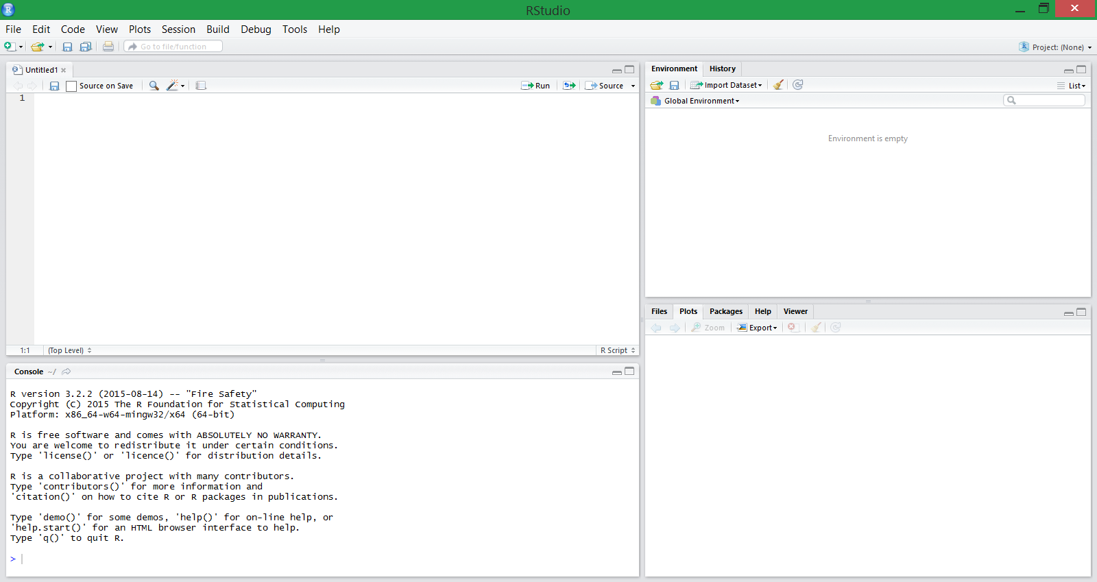
RStudio Environment
Script Window
Environment
Console window
File manager/Plots/Help

Slide 18
RStudio IDE
Script Window
Draft and save code
Write a script to run in the console (CTRL+R or CTRL+Enter, or pressing Run)
Console
Where the code goes once run
Shows input (blue), output (black) and any errors or warnings (red)
Environment
Shows saved variables and datasets
File Browser/Plots/Help…
Show files in working directory and generated plots
Help window opens here

Slide 19
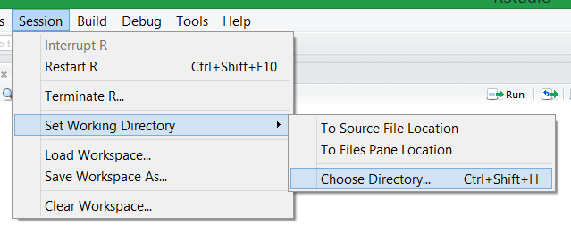
Working Directory
The working directory is the ‘home base’ of your R program. All files are written to and read from the working directory. There are two ways to do this.
1) Using the user interface
Session → Set Working Directory → Choose Directory…
2) Use the setwd()function
Get the working directory with getwd().
setwd("c:/tmp")

Slide 20
R: Hello World!
print("Hello World!")
The print function will print to the console the input it is given.

Slide 21
Try it: R Printing
Question 1: Write a R program that prints "I am awesome!".
Question 2: Write a R program that prints these three lines:
I can program in R!
I can program in Python!
I can program in at least 2 languages! Can you?
Notes:
print("I am awesome!")
print("I can program in R!")
print("I can program in Python!")
print("I can program in at least 2 languages! Can you?")

Slide 22
Basics of R
R is case-sensitive.
R commands may be separated either by a semi-colon or a newline.
Brackets { } are used to group commands together.

Slide 23




Basic Syntax of R
Commenting is done with a #. There are no multiline comments.
Variables are assigned using a <-
To get help for any function use help(function)or ?function

Slide 24

Calculations in R
R has standard math operators (+, -, *, /, ^ (power)).
Predefined functions in R:
Trigonometric functions: sin , cos , tan
Exponential: exp, log (natural log), log10
Note: pi returns the value of π BUT you can (accidentally) redefine it.

Slide 25
R Question
Question: How many of the following statements are TRUE?
1) R is case-sensitive.
2) A command in R can be terminated by a semi-colon.
3) Indentation is the syntax used to group statements together.
4) A single line comment starts with #.
5) The = is the preferred syntax for variable assignment.
A) 0 B) 1 C) 2 D) 3 E) 4
Notes:
Answer: D
True: #1, #2, #4
Note: = does work for assignment in some cases. Messy rules that we will ignore.
25

Slide 26
R Data Types
Numeric
Decimal values
Integer
Can be created using as.integer()
Complex
Complex values (i.e. a+bi)
Logical
TRUE/FALSE. Can be denoted using T/F.
Character
String values denoted with single or double quotes.

Slide 27
Try it: R Variables and Expressions
In a R program:
Make a comment with your name and student number
Calculate the following:
4*5-12^3
e^{4*3}
sin(4*pi-6)
Make the following variables. What types do you think they are?
var1 = TRUE
var2 = F
var3 = 3^4 - 10
var4 = “Hello World”
You can print out the responses by typing the variable name in the console and pressing Enter.
Notes:
4*5-12^3
exp(4*3)
sin(4*pi-6)
typeof(var1) is logical
typeof(var2) is logical
typeof(var3) is double
typeof(var4) is character

Slide 28
Comparisons
Comparison operators in R:
> - Greater than
>= - Greater than or equal
< - Less than
<= - Less than or equal
== - Equal (Note: Not "="!)
!= - Not equal
The result of a comparison is a Boolean value which is either TRUE or FALSE.

Slide 29
Conditions with and, or, not
Operation | Syntax | Examples | Output
AND (True if both are True) | & | TRUE & TRUE FALSE & TRUE FALSE & FALSE | TRUE FALSE FALSE
OR (TRUE if either or both are TRUE) | | | TRUE | TRUE FALSE | TRUE FALSE | FALSE | TRUE TRUE FALSE
NOT (Reverses: e.g. TRUE becomes FALSE) | ! | !TRUE !FALSE | FALSE TRUE

Slide 30
Decisions
Decisions allow different actions based on conditions. R syntax:
The statement after the if condition is only performed if the condition is TRUE.
If there is an else, the statement after the else is done if condition is FALSE.
Indentation is recommended but not required.
Statements are grouped using brackets which are optional if only one statement.
if (condition)
{ statements
}
if (condition)
{ statements
}
else
{ statements
}
Done if condition is TRUE
Done if condition
is FALSE

Slide 31
Decisions if/else if Syntax
if (condition)
{ statement
} else if (condition)
{ statement
} else if (condition)
{ statement
}else
{ statement
}
if (n == 1)
{ print("one")
} else if (n == 2)
{ print("two")
} else if (n == 3)
{ print("three")
} else
{ print("Too big!")
}

Slide 32
The for Loop
A for loop repeats statements a given number of times.
R for loop syntax:
Up to and including
ending number
for (i in seq(1,10,1)){
print(i)
}
Increment
Starting number

Slide 33
Defining and Calling a Function in R
Function Name
function Keyword
Parameter Name
doubleNum <- function(num)
{ # Return number doubled
num <- num * 2
print(paste("Num:",num))
return (num)
}
Call function by name
Argument
n = 20
print(doubleNum(n)) # 40
Notes:
paste("abc",5,sep="")

Slide 34
Try it: R Decisions, Loops, and Functions
Question: Write a R program that contains a function called printEven that prints the first 10 even numbers starting from an input number passed in.
Note: Modulus is %%.
Test your function with input values 5 and 10.
Notes:
printEven <- function(num)
{
if (num %% 2 == 1)
num = num + 1
for (i in seq(num,num+19,2))
print(i)
}
printEven(5)

Slide 35
Reading Data Sets
Read delimited data:
data <- read.table("filename",sep="",header=TRUE)
Filename – name of file to read in i.e. input.txt
sep - separator character. Default "" uses any type of whitespace. Others: , \t ;
header – if TRUE then the first row is used for variable names
Read CSV data:
data <- read.csv("filename", header=TRUE)
Specific case of read.table() with sep=","

Slide 36
head() and tail()
After reading a data set, use head() to show the first 6 rows and tail() to show the last 6 rows.
data <- read.csv("data.csv", header=TRUE)
head(data)
tail(data)
head(data, 10) # First 10 rows
tail(data, 20) # Last 20 rows

Slide 37
Reading Data with R
Question: How many of the following statements are TRUE?
1) R can read comma separated and tab separated files.
2) If HEADER=TRUE, the first row of the file is assumed to be column names (i.e. not data).
3) If HEADER=TRUE and there is no header row, the program crashes.
4) By default, head() and tail() return 10 rows.
5) A parameter passed into head() can change # of rows returned.
A) 0 B) 1 C) 2 D) 3 E) 4
Notes:
Answer: D
True: #1, #2, #5
37

Slide 38
Data Structures - Vectors
A vector is an indexed list of data of any type.
Create vectors using a colon or seq() (R’s version of range).
1:10
seq(5, 1, by = -0.5) # Default by is 1
Create an empty vector with c(), or fill it by specifying elements.
c()
c(4, 3, 5, 'a', 'd')
Access elements in a vector using []
myVector[i] # Returns ith element of myVector
myVector[1] # Returns 4
Note: [] returns a vector with a subset of values. If only one index, get a vector with one element. Can also do: myVector[myVector > 3] would return a vector with (4, 5).
NOTE: First index is 1!

Slide 39
Vectors in R
Question: How many of the following statements are TRUE?
1) Vectors in R are indexed from 0.
2) 1:10 creates a vector of 10 numbers.
3) A vector may have data values of different types.
4) If data <- 1:5, then data[2]+data[3] = 3.
A) 0 B) 1 C) 2 D) 3 E) 4
Notes:
Answer: C
True: #2, #3
#4 is 5.
39

Slide 40
Data Structures - Matrices
A matrix is a structure of rows and columns where each data value is the same data type. All rows must have the same length. All columns must have the same length.
Create a matrix from the vector x using matrix()
matrix(x, nrow = 5, ncol = 3, byrow = FALSE)
# Starts at [1,1] and fills the column first before # going onto the next column.
# Need to only specify ncol or nrow
Access elements using [row, col]. Leaving one of them blank returns the whole row or column.
myMatrix[i,j] # Returns ith row and jth column

Slide 41
Matrices and Vectors
Append a vector to a matrix as a row using rbind() :
myMatrix = rbind(myMatrix, vec)
Append a vector to a matrix as a column using: cbind():
myMatrix = cbind(myMatrix, vec)

Slide 42
Data Structures - Lists
A list is an ordered collection of objects of any type.
Create a list using list(). Specify names of elements by using name= inside the brackets.
myList = list(x = 1:4, y = c('a','b'))
# Creates a list with two elements x and y
Access elements using the double square brackets
myList[[2]] # Returns 2nd item of list (y)
myList[['x']] # Returns item with the name x
Notes:
With single bracket, like myList[1] would get a List that contains x=1:4. If use myList[[1]], get sequence 1:4.
Can also use myList$x to extract element by name.
Double brackets and $ only return one value. Single brackets return a sublist.
Can use variable to index with double bracket but not with $. Example: val <- “x”; myList[[val]] works but not myList$val

Slide 43
Lists and Matrices in R
Question: How many of the following statements are TRUE?
1) Data values in a list may be of different types.
2) In a matrix, the number of rows and number of columns must be the same.
3) Given matrix m, m[2] would return all data in row 2.
4) Given matrix m, m[,2] would return all data in column 3.
A) 0 B) 1 C) 2 D) 3 E) 4
Notes:
Answer: B
m[2] is same as m[2,1] (2nd row, 1st column)
m[2,] would return all of row 2
m[,2] returns all data in column 2 (not 3)
43

Slide 44
Try it: Lists
Create a list called grades. Add in the following elements:
*Name (containing first and last name)
Student number
*Assignment grades
Midterm grade
The *’s indicate that the fields should have multiple entries.
Notes:
myList = list(name=c("Ramon","Lawrence"), number=9999999, grades=c(99,100,55), midterm=100)

Slide 45
Data Structures – Data Frames
A data frame is similar to a matrix but the columns can have different data types.
Note: Still have uniform length of rows and columns.
Data frames are a very common structure for data analysis.
Create a data frame by using data.frame(). Specify names of variables within the brackets.
myDF = data.frame(x = c(1:3), y = (2:4))
Change a matrix into a data.frame using as.data.frame().
myDF = as.data.frame(myMatrix)

Slide 46
Data Structures – Accessing Data in Data Frames
Access elements using [row, col] or $variable_name.
myDF[i, j] # ith row and jth column
myDF$x # Returns the column labeled x
Can add new column called vec into the data frame using $
myDF$new_col = vec # Adds vec as new_col
Notes:
When subset a number from a matrix, get a vector not a matrix. If want a matrix, use drop parameter like this: myDF[1, 2, drop = FALSE]
Removing na from a vector:
x <- c(5, NA, 4, NA)
na <- is.na(x)
x[!bad]
Removing na from two vectors x and y:
good <- complete.cases(x,y)
x[good]
y[good]
Removing na from a dataframe frame:
good <- complete.cases(frame)
frame[good,]

Slide 47
Data Structures - Factors
Factors are used for qualitative groups/categories (i.e. Male/Female). Use as.factor() to turn a vector or data.frame column into a factor.
myFactor = as.factor(x)
myDF$x = as.factor(myDF$x)
Access elements using []:
myFactor[i] # Returns ith element
Can use class() or str() to gain information about the type and/or structure of your variable/data. str() gives more detail.

Slide 48
Question on Data Structures
Question: How many of the following are TRUE?
Matrices must have the same number of rows as columns.
Vectors must contain only one data type.
A factor can contain only characters.
A Data frame’s columns can be of varying length.
A) 0 B) 1 C) 2 D) 3 E) 4
Notes:
A - none are true

Slide 49
Subsets
Subsetting is used to extract data with particular values.
Syntax:
subset(data, condition)
Example:
# Only return data for province of BC
cars_bc = subset(cars, prov == 'BC')

Slide 50
Try it: Data Frame
Create a data frame mydata with the following column names/data:
id - numbers 1 to 5
location - "BC", "BC", "AB", "MB", "BC"
value - 10, 20, 30, 40, 50
Make location a factor.
Add one more column to your data frame that is a factor:
success - "Y", "N", "N", "N", "Y"
Display only the data from BC and value >= 20.
Notes:
mydata <- data.frame(id=1:5, location=c("BC","BC","AB","MB","BC"), value=c(10,20,30,40,50))
mydata$location <- as.factor(mydata$location)
successData <- c("Y","N","N","N","Y")
mydata$success <- successData
subset(mydata, location=='BC' & value >= 20)

Slide 51
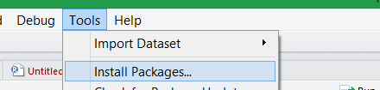
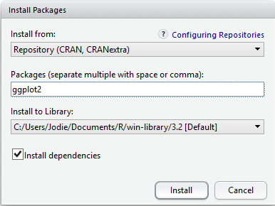
Visualizing Data in R
R supports several graphing libraries to produce graphs for qualitative and quantitative data including bar charts, histograms, and box plots.
We will use the package ggplot2. gg stands for Grammar of Graphics.
To install tools → Install Packages... Then input ‘ggplot2’
Notes:
Visualization options:
http://docs.ggplot2.org/current/
Adding axis:
http://www.r-bloggers.com/how-to-format-your-chart-and-axis-titles-in-ggplot2/

Slide 52

Graphs for Qualitative Data: Frequency Table
Frequency tables summarize the number of observations in each group.
Use: table(variable)

Slide 53
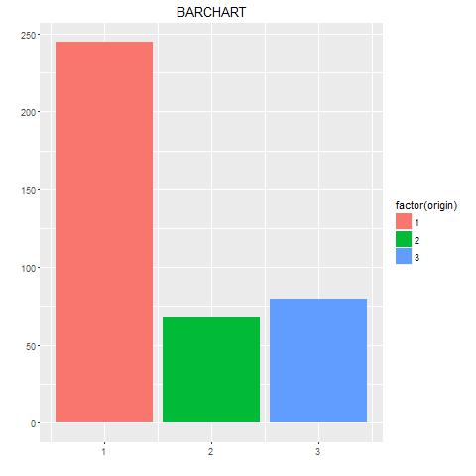
Graphs for Qualitative Data: Bar Charts
Bar charts have each group along the x-axis and a vertical bar with the height representing the number of observations of each group.
Code example:
ggplot(Auto, aes(x = origin))+
geom_bar(aes(fill=factor(origin)))
+ xlab("") + ylab("")
+ ggtitle("BARCHART")
Using the dataset Auto in the ISLR package.
Notes:
Start with the ggplot() command and put origin as x.
Use geom_bar() to create the bar chart
Use fill = factor(origin) to colour the bars for different groups.

Slide 54
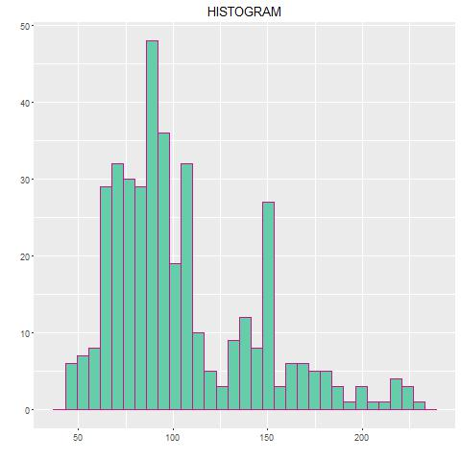
Graphs for Quantitative Data: Histogram
A histogram is similar to a bar chart, but the x-axis is divided into bins.
The variable of interest is on the x-axis, and the y-axis represents count of observations within each bin.
Visualizes the data distribution.
Code example:
ggplot(Auto, aes(x = horsepower))
+ geom_histogram(color = 'mediumvioletred', fill= 'mediumaquamarine')
+ xlab("") + ylab("") + ggtitle("HISTOGRAM")
Notes:
Start with the ggplot() command, and put horsepower as x.
Use geom_histogram() to create the histogram
You can specify the number of bins in geom_histogram(}. Default is used if blank.
Use color for the outline of the boxes, and fill for the inside of the boxes.
NOTE: colouring the outlines a separate colour can help to make the graph more readable.
A full list of colours can be found here: http://www.stat.columbia.edu/~tzheng/files/Rcolor.pdf

Slide 55
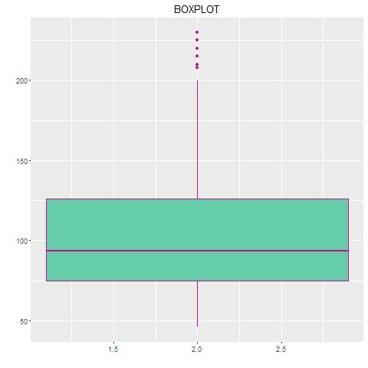
Graphs for Quantitative Data: Boxplot
A boxplot is a visualization of the 5 number summary.
Groups along the x-axis
Data values along the y-axis
Lowest and highest points are the min and max of the data respectively.
Bottom of box is Q1 and top is Q3
Median is represented as the bar inside the box.
Single points represent outliers.

Slide 56
Boxplot Example Code
ggplot(Auto, aes(x = origin, y = horsepower))
+ geom_boxplot(color = 'mediumvioletred', fill= 'mediumaquamarine')
+ xlab("") + ylab("")+ ggtitle("BOXPLOT")
Notes:
We will use the dataset Auto provided in the ISLR package.
Start with the ggplot() command, and put origin as x and horsepower as y.
Use geom_boxplot() to create the boxplot
You can specify the color and fill in geom_boxplot if you wish. Default is black and white.

Slide 57
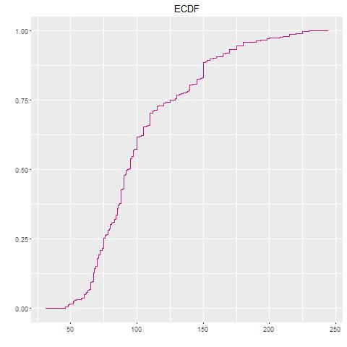
Graphs for Quantitative Data: ECDF
An Empirical Cumulative Distribution Function (ECDF) plot shows values along the x-axis and quantiles along the y-axis.
Each data point is plotted along with its corresponding quantile.

Slide 58
ECDF Example Code
ggplot(Auto, aes(x = horsepower))
+ stat_ecdf(color = 'mediumvioletred')
+ xlab("") + ylab("")+ ggtitle("ECDF")

Slide 59
Graphical Summary Question
Question: How many of the following are TRUE?
Bar charts and histograms will work for the same variables.
Boxplots show a 5 number summary.
Variable type does not matter, any graph can be used.
Histograms can give an idea of the distribution of a variable.
A) 0 B) 1 C) 2 D) 3 E) 4
Notes:
C: #2 and #4 are true

Slide 60
Try it!
1) Using the car data from the data.frame example, create a bar chart for the variable prov.
2) Use the cars data and create a histogram of any variable.
3) Create a boxplot for the variable of your choice!
What are the median and minimum values? Can you estimate the IQR?
4) Make an ECDF for the variable of your choice.
Recalling that Q1, median, and Q3 are the 0.25, 0.5, and 0.75th quantiles, what is your best guess at these values from reading off of the graphs?
Notes:
TODO

Slide 61
Confidence Intervals
62 percent of US College students miss a class due to excessive drinking. The result is accurate within 1.7 percentage points 19 times out of 20.
Taking the pieces out of the above statement we have:
62 is the estimated percentage
1.7 is the margin of error
19 times out of 20 is the stated confidence -> 100%(19/20) = 95%
This is a 95% confidence interval: (60.3, 63.7)

Slide 62

Confidence Intervals (2)
General form:
$$(μ −me, μ+me)$$
Interpret a 95% confidence interval as that we are 95% confident that the interval will contain the true value of the parameter.
Notes:
CI can be of any strength although the standard is 95%.

Slide 63
Hypothesis Testing
Hypothesis testing is used to determine if a relationship exists between two sets of data and make decisions/conclusions about that relationship.
Hypothesis testing is useful for:
business - determining effectiveness of marketing, identifying customer buying properties, online advertising optimization
science/social science - determining if data sets match a model, understanding scientific process based on collected data values, analysis of study data
Notes:
https://en.wikipedia.org/wiki/Statistical_hypothesis_testing

Slide 64
Probability distribution functions
Probability distribution functions
Rnorm – random Normal variables
Dnorm = evaluate norm probability density
Pnorm
Qnorm – default distribution is mean=0 and sd=1
D for density
R for random number generation
P for cumulative distribution
Q for quantile function
Notes:
Set.seed(1) – sets random generator seed before using rnorm
Other: rpois – Poisson distribution

Slide 65
Hypothesis Testing Steps
1) Declare hypotheses statement and null hypothesis
2) Decide on test statistic
3) Use P-value and/or confidence interval to make decision/conclusion
A p-value of 0.05 “signifies that if the null hypothesis is true, and all other assumptions made are valid, there is a 5% chance of obtaining a result at least as extreme as the one observed” (http://www.nature.com/news/statisticians-issue-warning-over-misuse-of-p-values-1.19503)
Data is used as evidence. Perform a test in order to make a decision: reject the null hypothesis or fail to reject the null hypothesis.
NOTE: We cannot prove if the null hypothesis is true or false. We can only show that there is evidence to suggest one conclusion or another.
Notes:
Def: statistic - a value calculated from a sample often to summarize sample for comparison purposes (Wiki)

Slide 66
Assumptions
There are assumptions that need to be met before performing statistical tests.
For the one sample case:
Population of interest is normally distributed
Independent random samples are taken
For the two sample case:
The two samples are independent
Populations of interest are normally distributed

Slide 67
One Sample Test
A one sample test is used when a sample is compared to a model or known population/estimate.
As an example, using the car data test if the average mileage is different than 10 km/L.

Slide 68
One Sample Test: Hypotheses Statements
Null hypothesis (H₀) always contains a statement of no change (=).
Alternative hypothesis (H_{A}) can be one sided (< or >) or two sided (≠).
H₀: µ = test_number
H_{A}: µ ≠ test_number
Car mileage example:
H₀: µ = 10
H_{A}: µ ≠ 10

Slide 69

One Sample Test: Calculate Test Statistic
For the one sample test the t-test statistic is calculated as:
$$t= \frac{\overline{y} − μ}{s/{\sqrt{n}}}$$
$\overline{y}$ is sample mean, s is sample standard deviation, n is sample size, $μ$ is specified mean value
R code:
t.test(x = car_data$km.L,
alternative = c("two.sided"), mu = 10)
Notes:
Load car data:
car_data <- read.csv("car_data.csv")
t-test statistic assumptions: (normal population or n >30) and st. dev. (sigma) unknown

Slide 70
One Sample Test: Decision and Conclusion (using P-value)
If p-value > 0.05, the probability of seeing a sample mean more extreme is not that unlikely.
Fail to reject the null hypothesis
There is no evidence to suggest that the mean value of VARIABLE is less than, greater than, or different than the test value.
If p-value < 0.05,
Reject the null hypothesis
There is evidence to suggest that the mean value of VARIABLE is less than, greater than, or different than the test value.

Slide 71
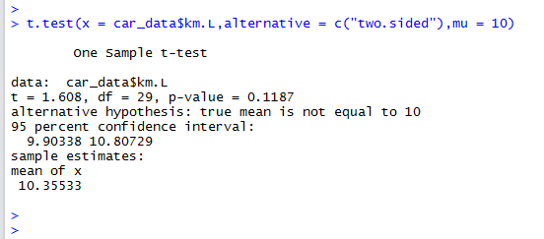
One Sample Test: Decision and Conclusion (using P-value) Example
P-value = 0.1187 > 0.05 => Fail to reject the null hypothesis
There is no evidence to suggest that the mean mileage is not 10 km/L.
Note: Unable to claim that either the null or alternative hypothesis is true. Can only reject or fail to reject the null hypothesis.

Slide 72
One Sample Test: Decision and Conclusion (using CI) Example
Can also make a conclusion (reject or fail to reject) based on the confidence interval. We are 95% confident that the true mean mileage of the car lies within those bounds.
Since 10 km/L is within those bounds, fail to reject the null hypothesis.

Slide 73
Two Sample Unpaired
An unpaired (independent) two sample test compares two independent samples to determine if there is a difference between the groups.
Examples:
Compare effectiveness of two different drugs tested on two sets of patients
Experiment versus control samples

Slide 74
Two Sample Unpaired Example Hypothesis Statement
Using the beaver2 dataset in R, test the hypothesis that there is no difference between the mean active temperature and the mean non-active temperatures.
H₀: µ₁ = µ₂ → µ₁ - µ₂ = 0
H_{A}: µ₁ ≠ µ₂ → µ₁ - µ₂ ≠ 0

Slide 75
Two Sample Unpaired Example Test Statistic
Use t-test statistic.
R code:
# Need to set active to be a factor first
beaver2$activ = as.factor(beaver2$activ)
# Perform unpaired test
t.test(temp~activ, data=beaver2,
alternative=c("two.sided"), mu=0,
paired=FALSE)

Slide 76
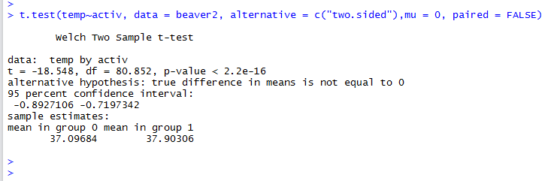
Two Sample Unpaired Example Decision and Conclusion (using P-value)
The p-value << 0.05.
Reject the null hypothesis. There is evidence to suggest that there is a difference between active and non active temperatures.

Slide 77
Two Sample Unpaired Example Decision and Conclusion (using CI)
The two sample case tests a DIFFERENCE between the groups (µ₁ - µ₂ ≠ 0). The CI stated above is the CI for the difference, µ₁ - µ_{2.}
We reject the null hypothesis because 0 is not contained in the interval.
If 0 was contained we would fail to reject the null hypothesis.

Slide 78
Two Sample Paired Test
A paired (dependent) two sample test compares two dependent samples to see if there is a difference between the groups.
This test typically uses multiple measurements on one subject.
Also called a "repeated measures" test.
Examples:
Affect of treatment on a patient (before and after)
Apply something to test subjects to see if there is an effect
Car example: Do cars get better mileage with different grades of gasoline?

Slide 79
Two Sample Paired Test Example Hypothesis Statement
The athlete.csv dataset contains data on ten athletes and their speeds for the 100m dash before training (Training = 0) and after (Training = 1).
Test the hypothesis that their training has no affect on the times of the athletes. Test to see if the mean of the difference is different than 0.
H₀: d= 0
H_{A}: d≠ 0

Slide 80
Two Sample Paired Test Example Test Statistic - R Code
# Read in the data
athlete = read.csv("athlete.csv", header=TRUE)
# Perform paired test
t.test(Time~Training, data = athlete, alternative=c("two.sided"), mu=0, paired=TRUE)

Slide 81
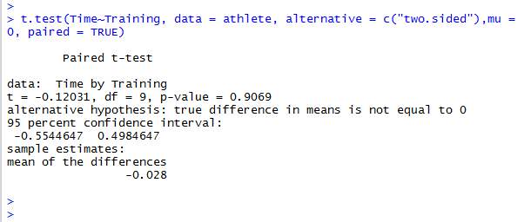
Two Sample Paired Test Example Decision and Conclusion (using P-value)
The p-value >> 0.05.
Fail to reject the null hypothesis. There is no evidence to suggest that there is a difference between pre and post training times.

Slide 82
Two Sample Paired Test Example Decision and Conclusion (using CI)
The two sample case tests for a difference between the groups (d ≠ 0). The CI is for the difference.
Fail to reject the null hypothesis because 0 is contained in the confidence interval.

Slide 83
Sampling Question 1
Question: How many of the following are TRUE?
Paired and unpaired t-tests are the same thing.
Confidence intervals can be of any level of confidence (not just 95%).
Confidence intervals can be used to make a conclusion about a hypothesis test.
Confidence intervals can be used to prove that the null hypothesis is false.
A) 0 B) 1 C) 2 D) 3 E) 4
Notes:
C: #2 and #3 are true

Slide 84
Sampling Question 2
Question: How many of the following are TRUE?
Unpaired t-tests test the difference between two means µ₁ and µ₂.
Paired t-tests can be used to compare the difference between two measurements on the same subject.
In both the paired and unpaired two sample cases, a confidence interval containing 0 would result in a decision of: fail to reject the null hypothesis.
In the one sample t-test, a confidence interval containing 0 would result in a decision of: fail to reject the null hypothesis.
A) 0 B) 1 C) 2 D) 3 E) 4
Notes:
D
1 – 3 are true

Slide 85
Hypothesis Testing Question
Question: How many of the following hypothesis questions should use two sample unpaired tests?
Is the average student mark in courses 70%?
Does a student's mark improve after studying?
Has the average student height increased since 1990?
Does radiation reduce the size of tumors when used to treat patients?
Is aspirin more effective than Tylenol for treating headaches?
Are college graduates better than high school graduates at standardized tests?
A) 0 B) 1 C) 2 D) 3 E) 4
Notes:
D - 3
1 - one sample
2 - two sample paired (same student)
3 - two sample unpaired (two district student populations)
4 - two sample paired (same patient), although could argue against control/experiment groups in which case two sample unpaired
5 - two sample unpaired
6 - two sample unpaired

Slide 86
Try It: Hypothesis Testing
Using the car data, test the hypothesis that the mean distance at each fill up is less than 450km.
Use the car data to see if the mean distance for Alberta fill ups is different than the mean distance for B.C. fill ups.
Notes:
1.
t.test(x = car_data$Distance, alternative = c("less"), mu = 450)
2.
t.test(Distance~prov, data = car_data, alternative = c("two.sided"),mu = 0, paired = FALSE)
Note: Will need to add Province data to this data set.

Slide 87

Linear models in R
A linear model is an equation that relates a response variable (y) to some explanatory variables (x’s). The general form of the model is:
$$y= b_{0}+b_{1}x_{1}+b_{2}x_{2}+⋯+b_{n}x_{n}$$
Not all of the data points can fall on this line so the full equation is
$$y_{i}= b_{0}+b_{1}x_{1i}+b_{2}x_{2i}+⋯+b_{n}x_{ni}+ε_{i}$$
Where $ε_{i}$ denotes the error term associated with observation i.
Notes:
Assumptions:
Residuals are independent
Residuals are normally distributed
Residuals have a mean of 0 for all X
Residuals have constant variance

Slide 88
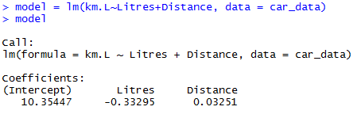
Fitting a Linear Model
lm(km.L~Litres+Distance, data = car_data)
The formula can then be created using the values stored in model$coefficients
Km.L = 10.35447 -0.33295*Litres + 0.03251*Distance

Slide 89
Conclusion
R is a free and open source programming language for statistical computing and graphics.
R contains many useful features for data analysis including data structures such as vectors and data frames that make it easy to perform statistical analysis and visualization.
R is often used for hypothesis testing and understanding how to properly setup and interpret a test is an important skill.

Slide 90
lapply
Lapply takes in a list and a function and applies the function to each element in the list.
Example:
X <- list(a=1:4, b=5:10)
Lapply(x, mean)
Can use anonymous functions as parameter to lapply function.
Lapply(x, function(n) n+1)
Sapply will simplify result to vector or matrix if can otherwise leaves it as a list.

Slide 91
File Operations for R
File.exists(filename) e.g. file.exists(“test.txt”)
Dir.create(directory) e.g. dir.create(“mydir”)
Download a file: download.file() from the Internet
Read an Excel file: read.xlsx() library(xlsx)
Read.xlsx(“my.xlsx”,sheetIndex=1,
- can read particular column and row ranges
Also write.xlsx()
Notes:
Packages to read XML and JSON.
Library(jsonlite)
Result <- fromJSON(“URL JSON document”)
jsonDoc <- toJSON(dataFrame, pretty=TRUE)

Slide 92
Data.table
Data.table inherits from data.frame
Written in C so faster – loading, subsetting, etc.
Library(data.table)
Data = data.table(…)

Slide 93
Summary() or str() on data frame to get an overview
Quantile()
Table() to make a table summarizing the data
Check for missing values: is.na() returns 1 if missing 0 if not missing
colSums() sums each column and returns a value for each column
In addition to == can use %in%:
Table(X$col %in% c(1,3,5))
Cross tabs using xtabs: xt <- xtabs(Freq ~ Gender + Admit, data)

Slide 94
Objectives
Understand purpose and usefulness of R
Types of data: qualitative, quantitative
Describe data use numerical summaries (measure of centre/spread)
Define and calculate: mean, median, variance, standard deviation, range
Define: quantile, quartile, interquartile range, five number summary
Perform matrix addition, subtraction, and multiplication
Install and use RStudio
Set and get the working directory
Write small programs/commands in R that may use variables, conditions, loops, and functions
Read in data sets from files
Use head and tail to explore a data set
Create and use data structures: vectors, matrices, lists

Slide 95
Objectives (2)
Use data frames/factors for data analysis
Create graphs/visualizations: frequency table, bar chart, histogram, boxplot, ECDF using ggplot2
Explain the purpose of confidence intervals
Perform hypothesis testing using R
Understand assumptions inherent in a t-test
Compute linear models using R

